Slide 1
The DXC Dandelion Program
Brisbane 2018
Notes:
1

Slide 2
Agenda
Welcome
Feedback Forms
DXC Dandelion Program Overview
Introduction to Work Experience Program Members
Presentation from the Team
Demonstration
Q&A
Notes:
1

Slide 3

Feedback Forms
Notes:
1

Slide 4

DXC Dandelion Program “Changing lives and our workplace”
Vision:
The Dandelion Program’s aim is to build the careers of people on the autism spectrum and instill the confidence in other organisations that with the correct framework, will benefit from the diversity of people on the autism spectrum.
Success to date:
In just over three years we have established 6 teams in 4 states, across Australia spanning a range of IT roles and now employ 60+ people on the spectrum.
Canberra 3 x teams – Cybersecurity, Analytics, Automation and monitoring, Testing
Brisbane – Test team
Adelaide – Test Team
Melbourne – Test Team & Cyber Security
Notes:
1

Slide 5
Team Members
Autism Support Consultant / Co-ordinator
Sharon Whip
Technical Lead
Corey Jansen
Test Manager
Ian Pereira
Development Team
Aaron, Adrian, Caleb, Chanade, Conor, Cameron, Dylan, George, Liam F, Liam V, Sam & Yane
Notes:
1

Slide 6
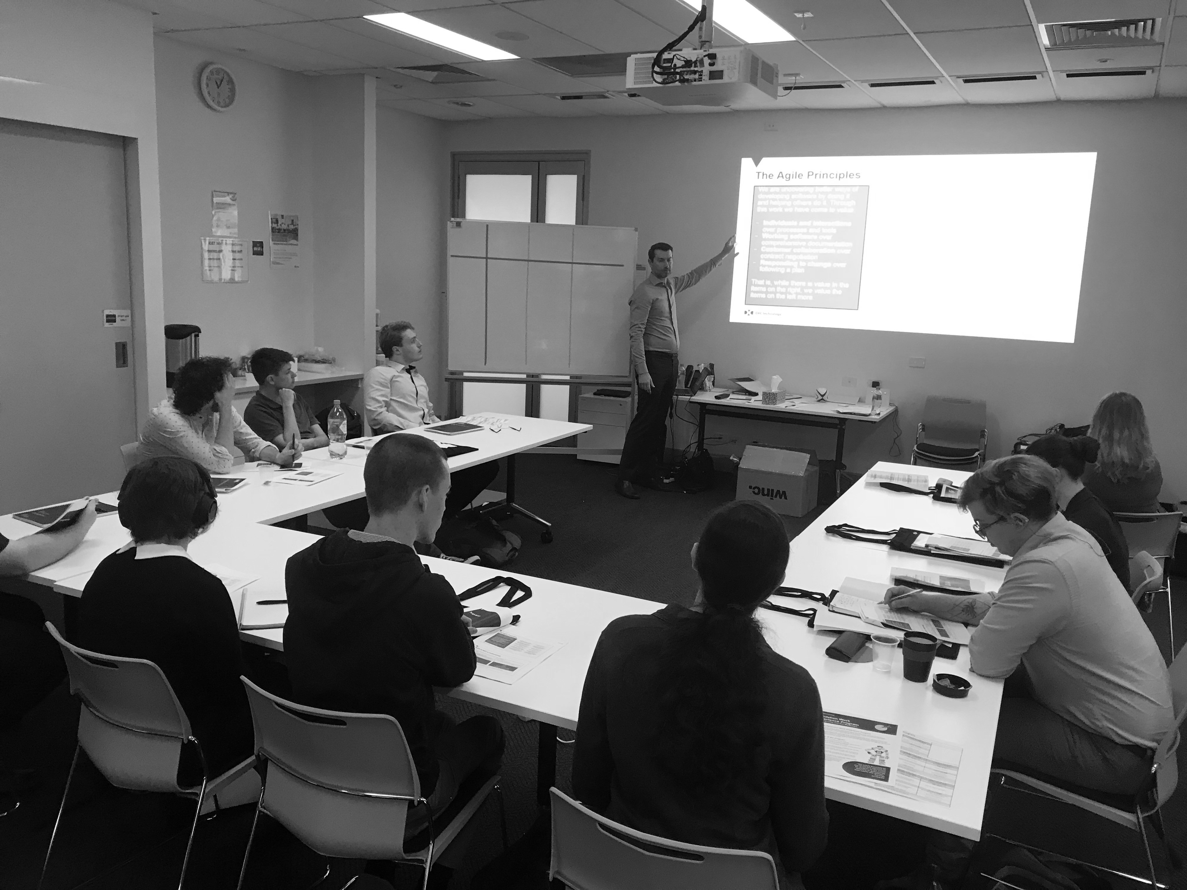
Agile Delivery Team
Notes:
1

Slide 7
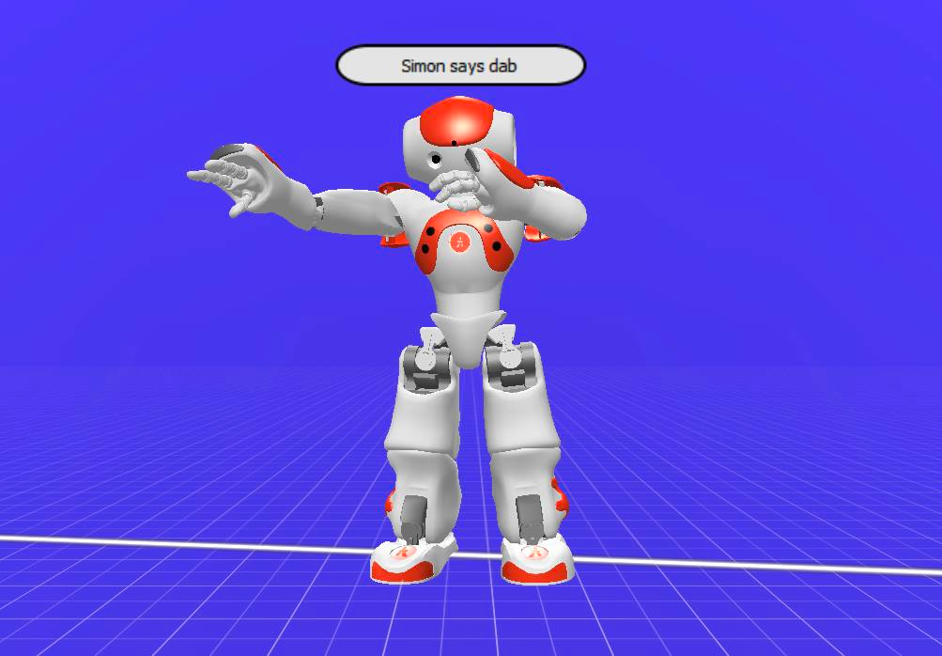
Project Overview
MEET YOUR ROBOTIC, TEACHER’S ASSISTANT!
ENTERTAINING AND EDUCATIONAL
GIVES GREETINGS AND INSTRUCTIONS
INCLUDES GAMES AND QUIZZESS
MAKES LEARNING FUN!

Slide 8






Agile Scrum framework
Start of Sprint
Product backlog
User stories
Story points
Sprint planning
Daily
Stand-up
Scrum Master
Development Team
Sprint Planning
Sprint Iteration
(1-4 weeks)
During the Sprint
The work
Daily stand-up meeting
Running tested features
Backlog refinement
Sprint Review
Sprint Retrospective
Product Backlog
Sprint
Backlog
Backlog Refinement
End of Sprint
Sprint review
Sprint retrospective
Product Owner
Potentially Shippable
Product Increment
Notes:
Go through this fast.
Will be going through each of the parts of the framework in the next slides, the ceremonies, the roles and the artifacts
Backlog refinement, clarify stories and estimate, no more than 10%
1

Slide 9
Backlog
Notes:
1

Slide 10
Sprint Overview
Notes:
1

Slide 11
Sprint Overview – Burndown Chart
Notes:
1

Slide 12
Choregraphe
Notes:
1

Slide 13
Testing
Notes:
1

Slide 14
Test cases

Slide 15
Issues

Slide 16
Documentation
Notes:
First Slide (Why)
The documentation process can be an underrated portion for most projects. It’s usually kept in the background or left until the last minute. This is especially true when using the Waterfall project module, where documentation is done once, without changing to new requirements.
Documentation is best done in the early stages of a project to define and outline project requirements. Then once the project is underway the process and results should be documented.
With an Agile style project module documentation is used to showcase and store project artifacts and data, record development and design processes, and store developer knowledge.
Some forms of documentation can delivered alongside the project, like technical guides, instruction manuals, marketing material or testimonials.
Team members, clients and stakeholders may greatly benefit from documentations. It can provide a general overview of the development, and provide further detail if the reader requires it.
1

Slide 17
Website
Notes:
1

Slide 18
Source Control
Notes:
1

Slide 19
Challenges
Notes:
<number>

Slide 20
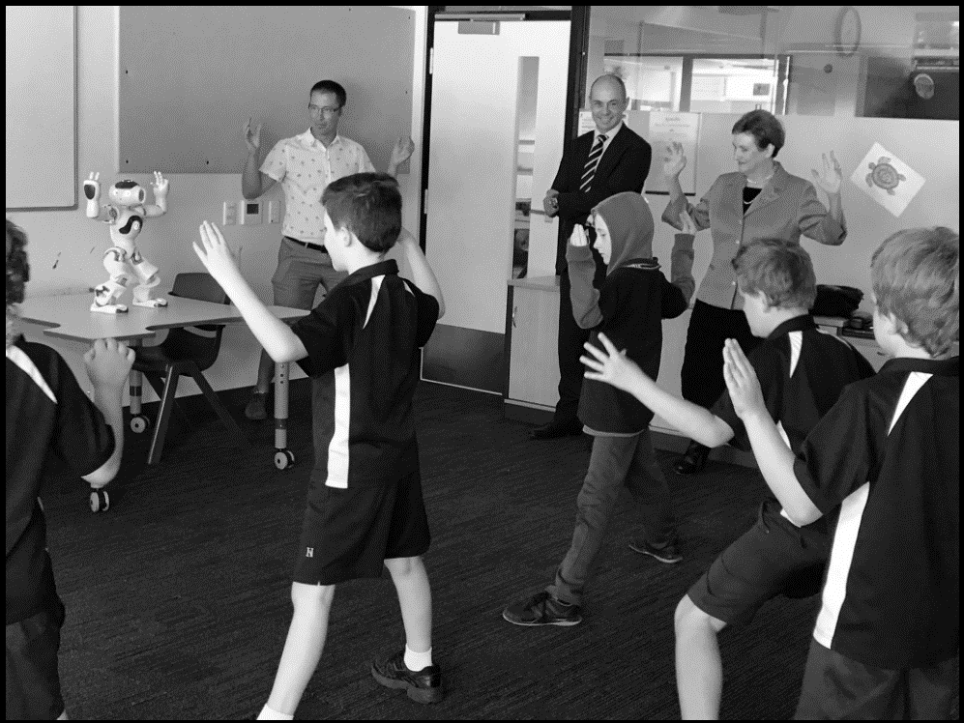
Demonstration
Notes:
<number>

Slide 21
Personal Experience
Notes:
<number>

Slide 22
Q & A
Notes:
<number>

Slide 23
Thank you.
Notes:
<number>

